Slide 1
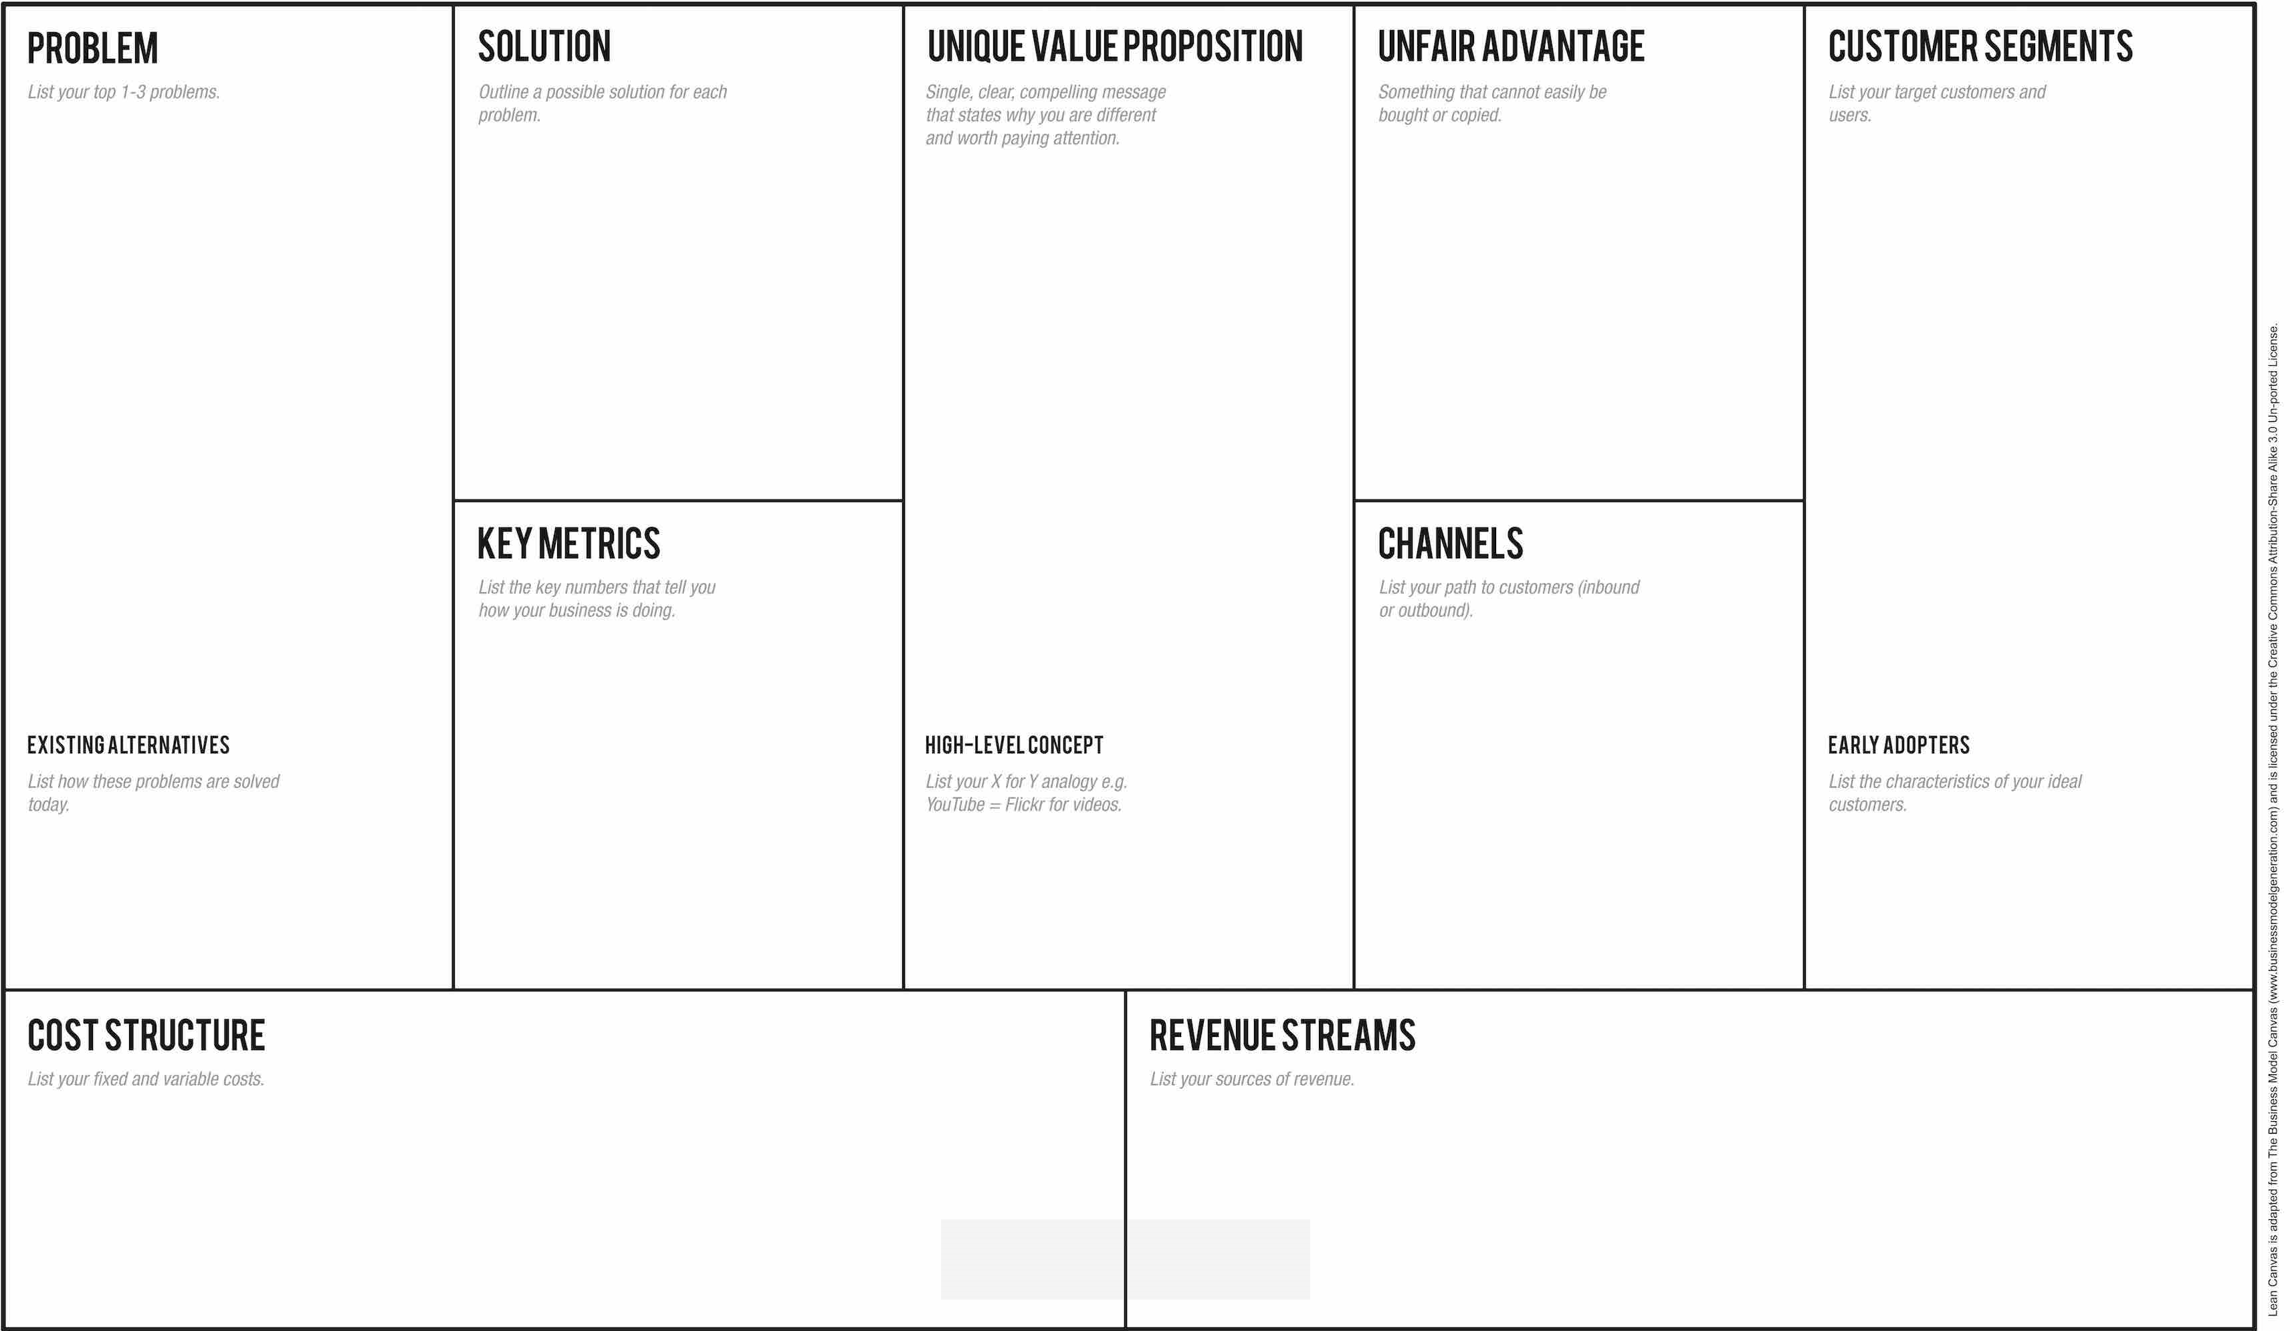
Wall crawling robots are hard to defeat.
Robot finds crawler and communicates. Coordinated attack.
Coordinated solution for tackling wall crawlers
(2-4 robots)
- Our domain expert has already built a sucessful melee bot
Robot teams that have no strategy regarding walls yet.
Crawler
Our bots
Comm.
- Sales price after Sprint 1 above avg
- Number of groups expressed interest
- Number of emails/ slack messages
Inbound:
- Robot Market page
- Sales pitch
Outbound
- Robot fair (lecture 3)
- Slack #robotmarket
Some robots guard corners to block wall crawlers.
Groups that fear wall crawlers after reading up on subject.
Fixed deadlines.
Time budget of 80 hours per person.
No paid overtime.
Besoke customer after Sprint 1
(25% payment first, remainder after Sprint 3)
Additional sales through Robot Market after Sprint 3.

Slide 2
Inbound:
- Robot Market page
- Sales pitch
-
Outbound
- Robot fair (lecture 3)
- Slack #robotmarket
-
Fixed deadlines.
Time budget of 80 hours per person.
No paid overtime.
Besoke customer after Sprint 1
(25% payment first, remainder after Sprint 3)
Additional sales through Robot Market after Sprint 3.

